Slide 1

Smart Tank – IoT Project
Computer Systems & Networks Assignment 2
HDIP in Computer Science
WIT
Israel Finnerty

Slide 2



Smart Tank Never run out of oil again!
Smart Tank takes accurate readings from your oil tank and relays them directly to you via, web email and using our latest app. If you have smart heating technology Smart Tank can also disable your heating until your tank has adequate levels of heating oil avoiding air locks and avoiding the need to bleed the boiler.
Using the latest in ultrasonic sensor technology Smart Tank will let you know exactly how much oil is left in your tank and provide you with the option of requesting refill quotes from local oil distributors.
By taking continuous readings Smart Tank will allow you to monitor your consumption of oil, carbon footprint emissions and find the peak oil usage times. Smart Tank can be retro fitted to any existing oil tank or added to the factory design of new oil tanks.
“Smart Tank – taking the stress out of oil heating”

Slide 3
Smart Tank Specification
The prototype will be installed in the cap of the oil tank and use an ultrasonic sensor connected to the raspberry pi to measure the levels of oil in the tank. Home heating oil tanks are within close proximity to the dwelling therefore the prototyped device can utilise the home wifi to deliver readings to the IoT platform and the end user. The end user will be able to monitor the levels of oil in the tank as well as track usage and emissions. The device will also connect to other smart home devices such as smart thermostat to disable the heating system if there is insufficient oil in the tank preventing air locks.
When oil is running low the user will be asked if they would like to receive quotes on refills or part refills from local oil distributors. This will use geolocation data on the device to send email requests for quotes and availability to local oil companies contained in a database.
Smart Home Device

Slide 4


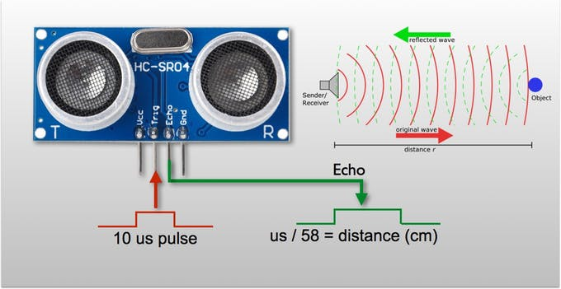
Ultrasonic Sensor Function

Slide 5
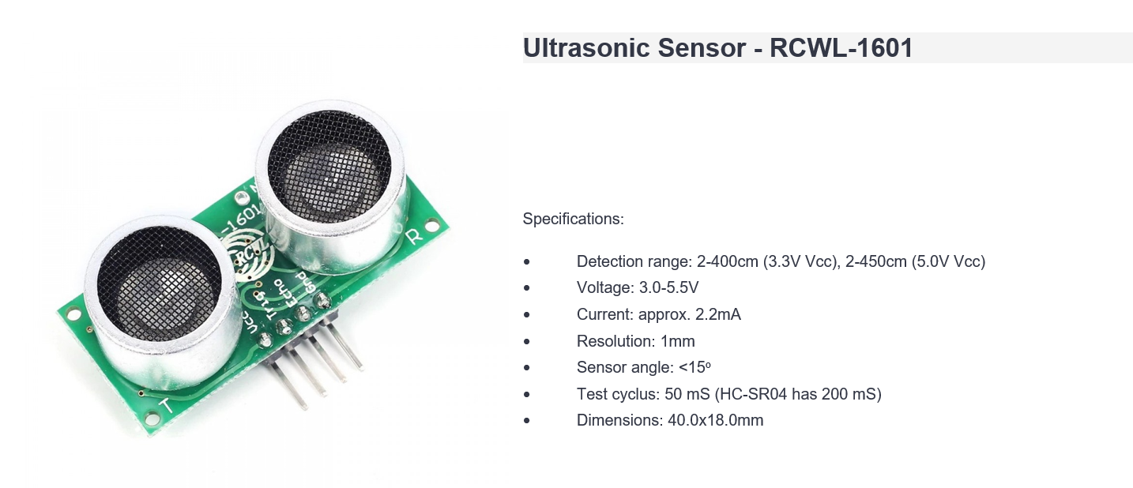
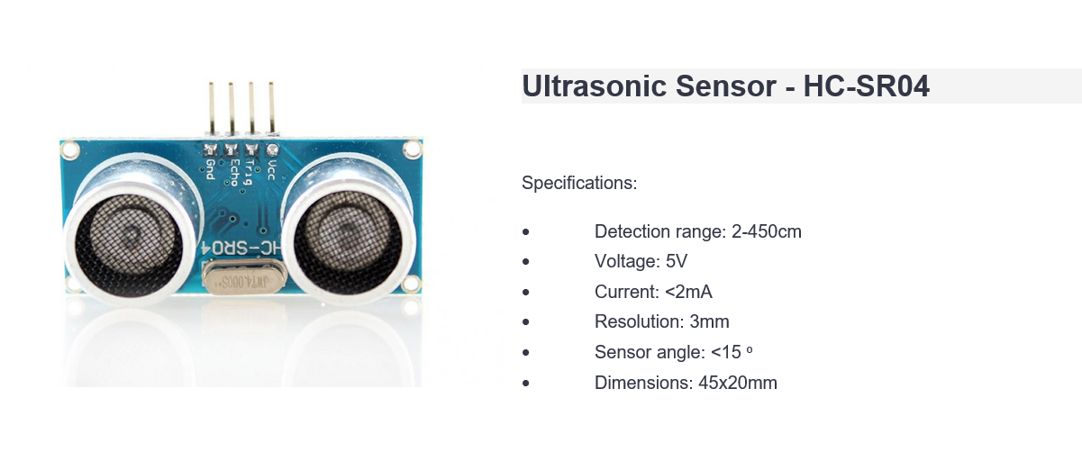
Which Ultrasonic Sensor?

Slide 6
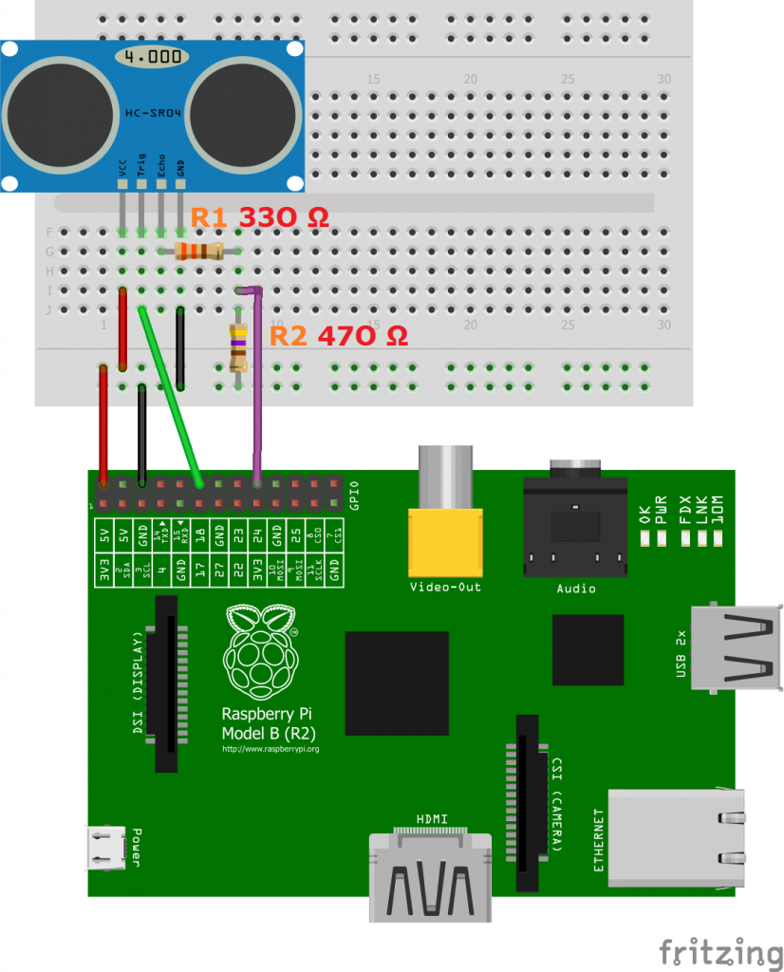
HC-SR04 Sensor Configuration
Connection to Pi via electronic breadboard and resistors

Slide 7
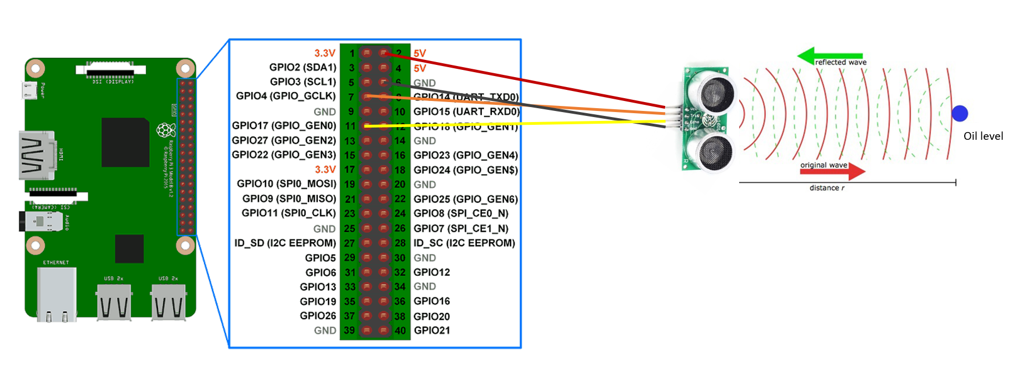
RCWL - 1601 Sensor Configuration
Direct connection to Pi

Slide 8
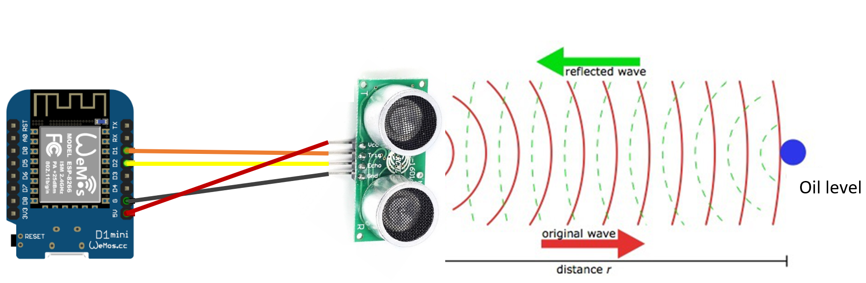
Alternative Prototype Sensor Connection with ESP-8266 Microcontroller

Slide 9

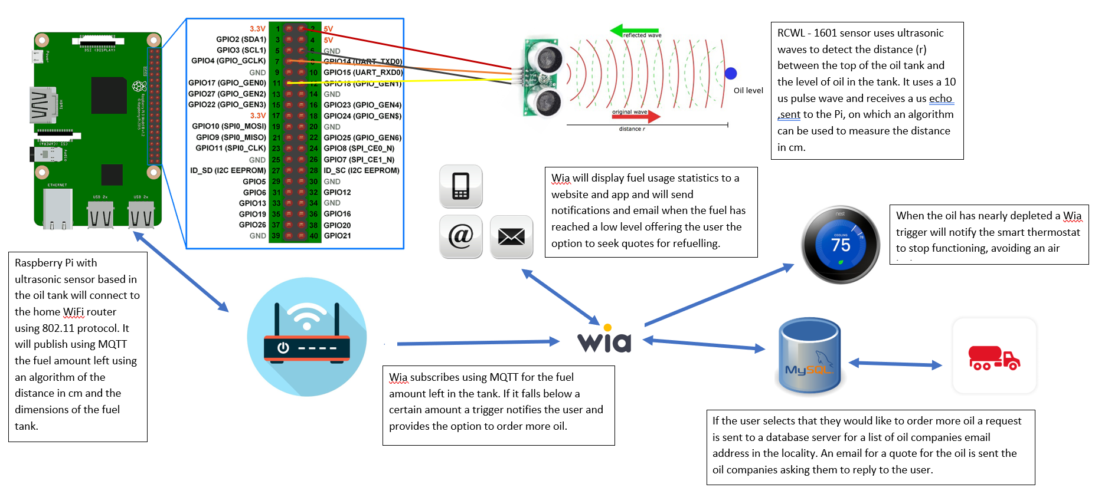
Full Pictorial Information Flow Representation

Slide 10
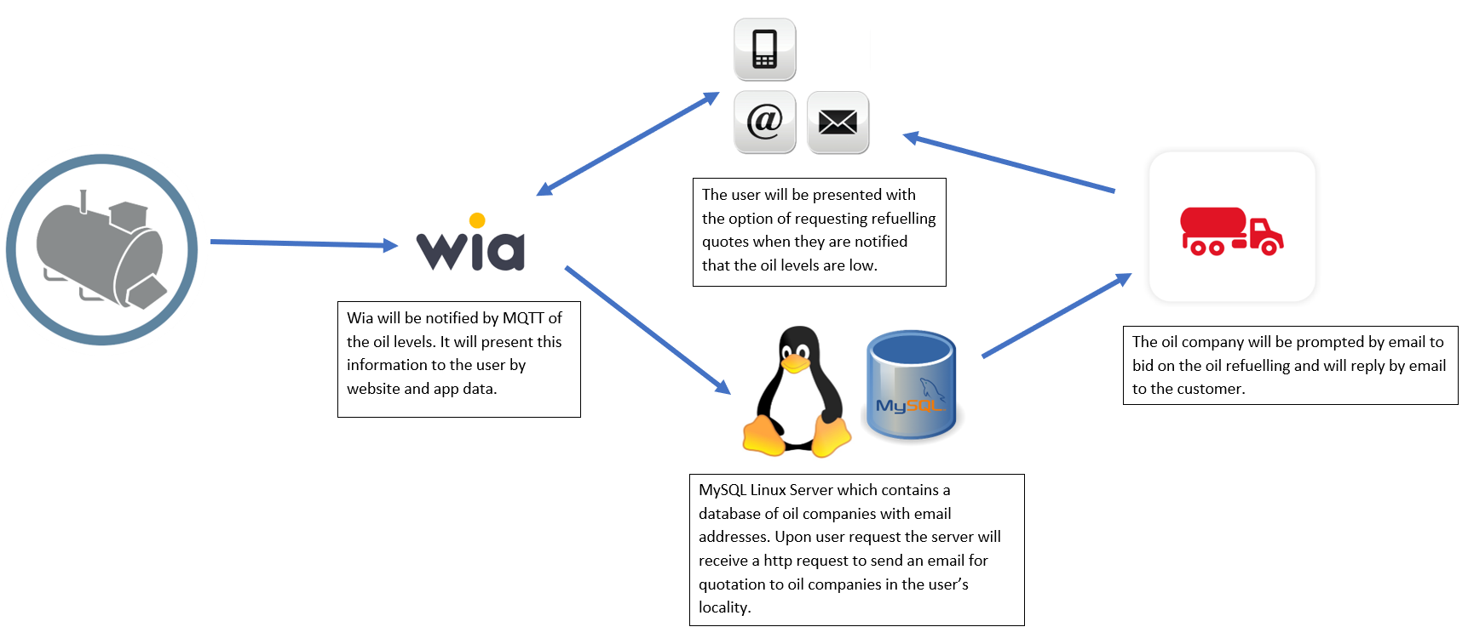
Fuel Reordering Flow Chart

Slide 11
Software Development
Wia platform with
widgets and triggers
Pi python scripts to analyse sensor data and publish to Wia using MQTT
Website to display usage statistics
Mobile App to display usage statistics give notifications and allow reordering
MySQL Linux server
with email functionality

Slide 12

Thank You
Smart Tank – IoT Project
Computer Systems & Networks Assignment 2
HDIP in Computer Science
WIT
Israel Finnerty

